Slide 1
The Effect of Social Media on Minority Viewpoints
Maria Khodak and Sen Francis

Slide 2
How can a group with a minority viewpoint overturn a majority converged idea?

Slide 3
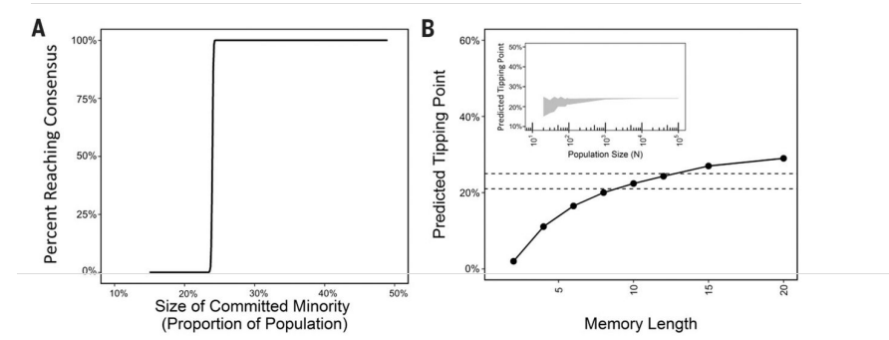
Critical Mass Theory

Slide 4
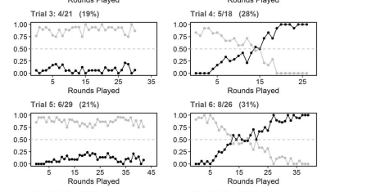
Data over time showing the adoption of the alternative convention. Gray lines express the popularity of the established convention while black is the alternative. On the left, players failed to mobilize while on the right players succeeded.

Slide 5
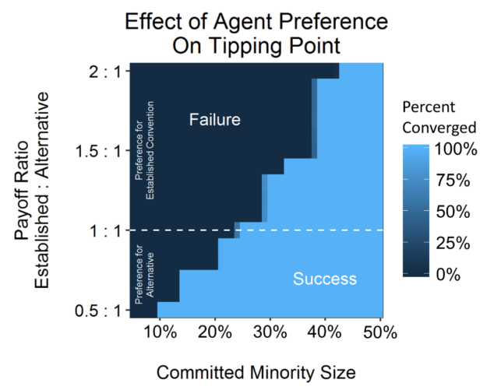
Study Conclusion
As percentage of minority population increases, percent reaching minority consensus increases
As memory length increases, estimated critical mass point increases

Slide 6
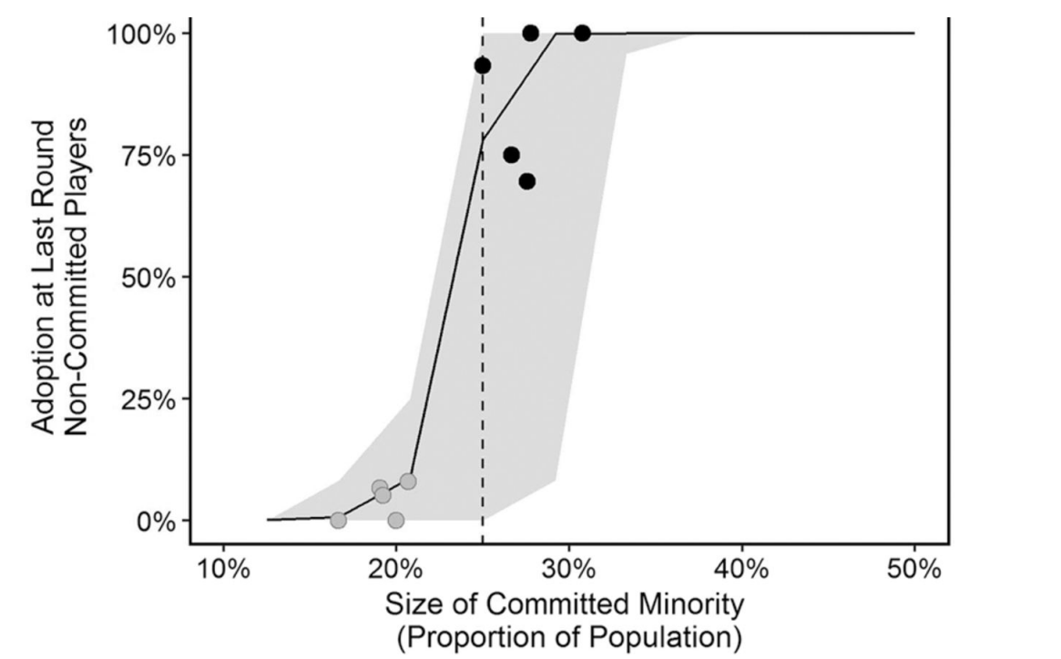
Evaluation of Study
Interesting results, powerful to know a minority group can influence the majority with consistent effort
Although results prove that the minority group can influence the majority, the applicability of the findings to specific social scenarios is unknown

Slide 7
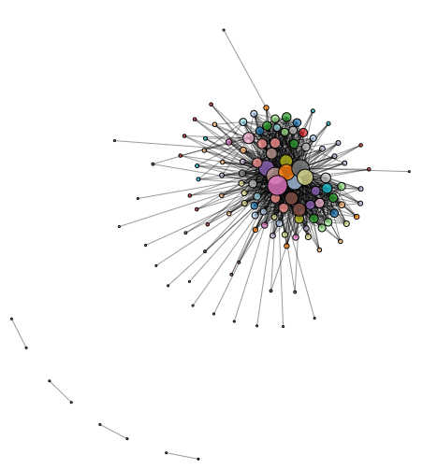
Determine the relationship between social media and the spread of minority views
What is this relationship?
Can we quantitatively represent this relationship?
  Rate of information spread
  Potential reach of information within the network
  How much influence particular users have within the network?

Slide 8
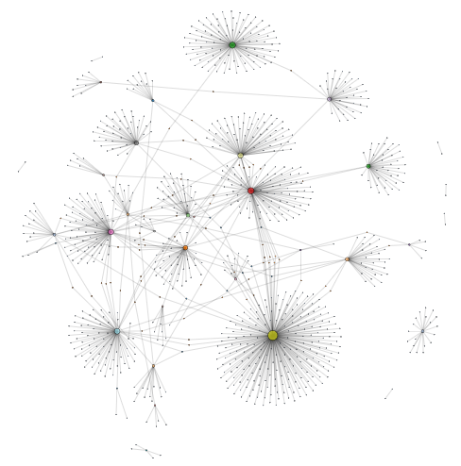
Our Experiment:
Determine how many people a tweet can reach in a network
  If this can be determined, can make inferences about how social media influences the spread of minority views

Slide 9
Data Processing
Python - Pandas, NumPy, NetworkX , Matplotlib
Pandas to parse data originally in a CSV
NumPy to manipulate data
NetworkX to use network algorithms
Matplotlib to produce graphs

Slide 10
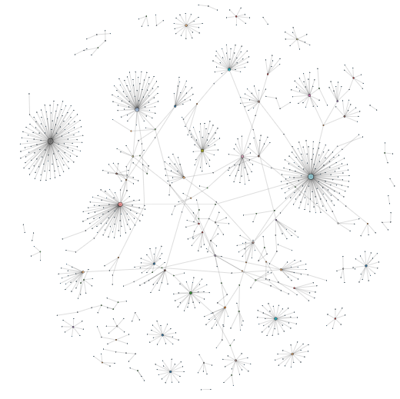
Data Collection
Retweet Networks from Network Repository
  #occupywallstnyc
  #damascus
  #lebanon
  #tlot

Slide 11
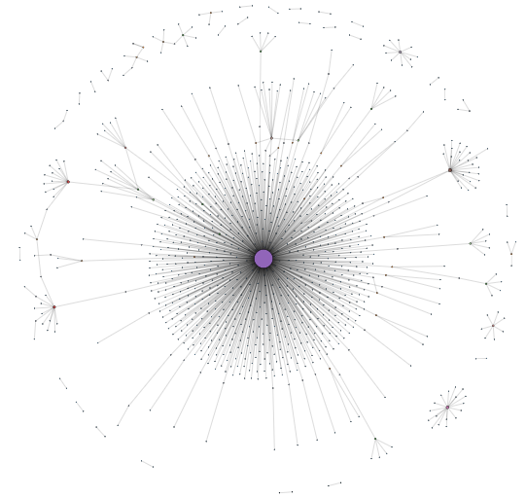
Twitter Retweet Network Overview
Sparse Network
Vertex = User
Retweets = Unweighted Edges
Data collection from social/political hashtags
~4K Nodes/Users
~4K Edges/Retweets

Slide 12
Experiment Metrics
Harmonic Centrality
  Measures how quickly a node is able to influence the network
Betweenness Centrality
  Measures how much a node controls information flow in the network
Katz Centrality
  Measures the local and global influence of a node
Note in the following slides centrality values are normalized so that they are in the range [0,100]

Slide 13
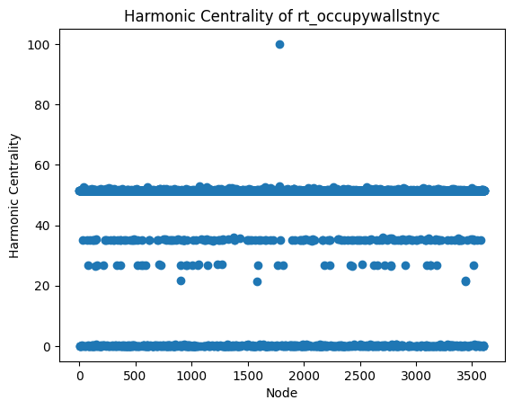
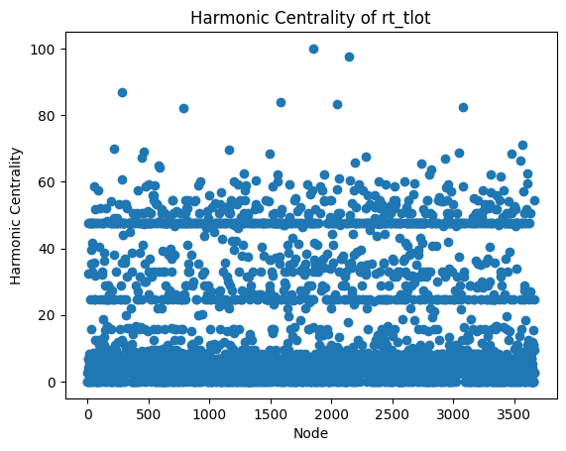
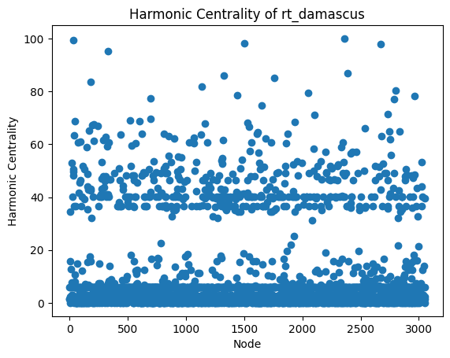
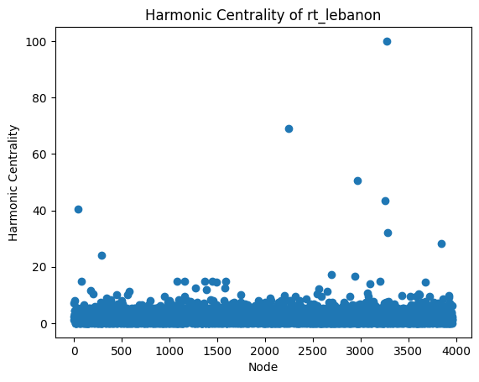
Mean: 42.162 | Variance: 365.601
Mean: 15.577 | Variance: 335.366
Mean: 9.804 | Variance: 264.674
Mean: 2.492 | Variance: 9.046
Harmonic Centrality Results

Slide 14
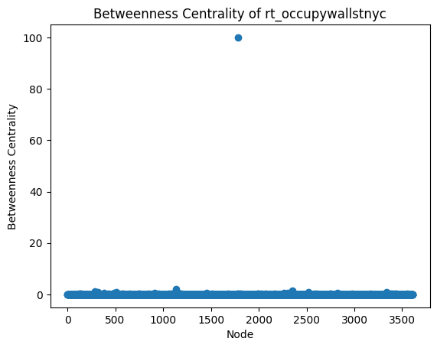
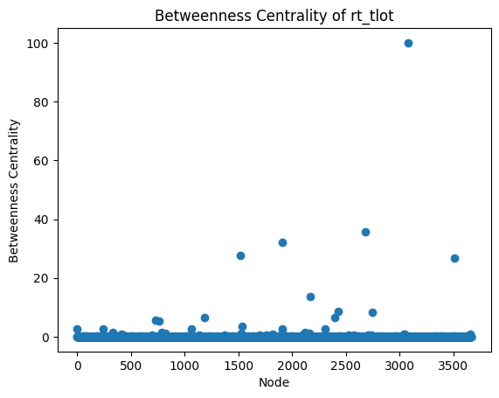
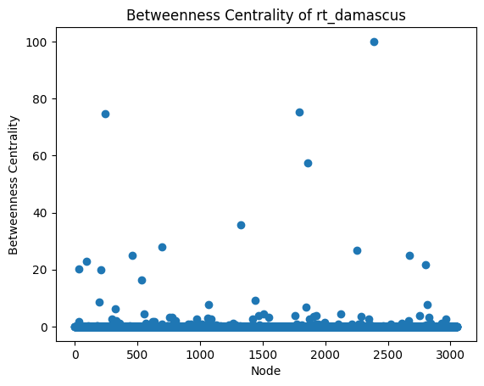
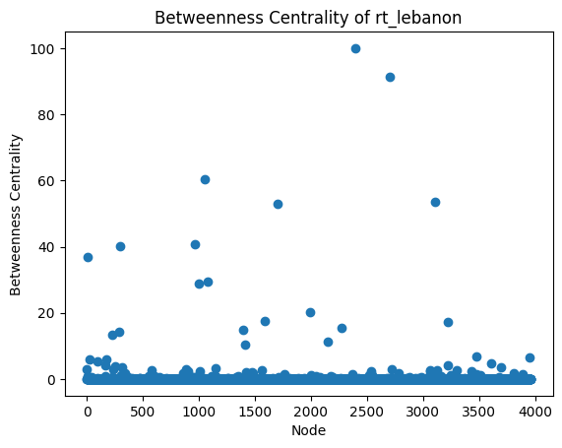
Mean: 0.035 | Variance: 2.774
Mean: 0.090 | Variance: 3.908
Mean: 0.234 | Variance: 10.183
Mean: 0.210 | Variance: 9.175
Betweenness Centrality Results

Slide 15
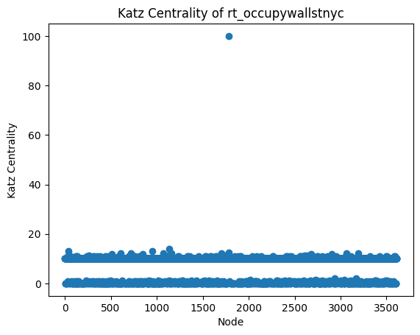
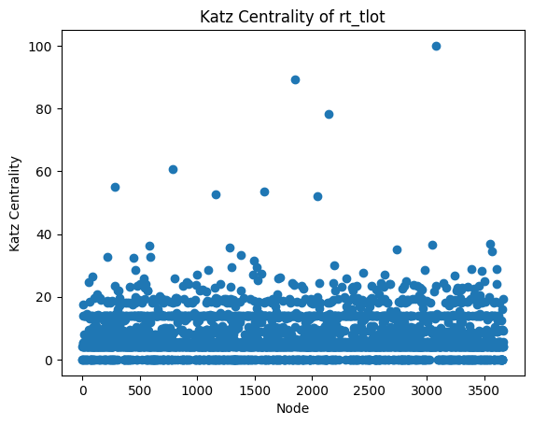
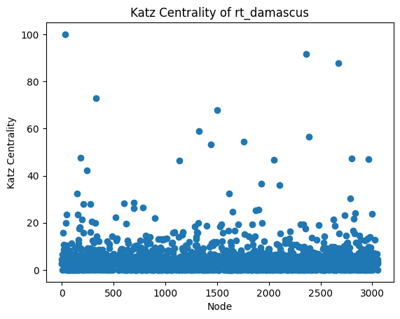
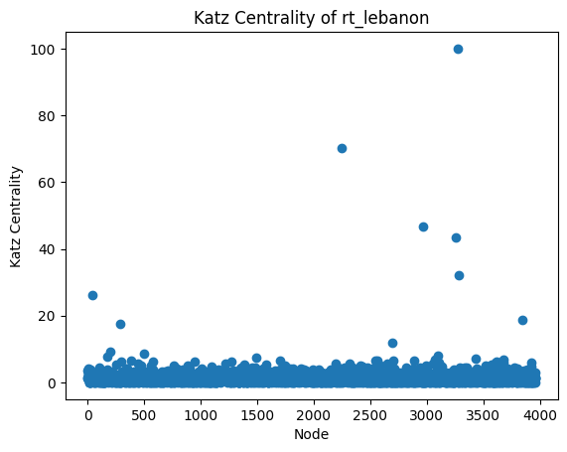
Mean: 7.898 | Variance: 19.034
Mean: 7.103 | Variance: 39.380
Mean: 4.361 | Variance: 29.037
Mean: 1.597 | Variance: 5.927
Katz Centrality Results

Slide 16
Most Influential Node (calculated using VoteRank)
#occupywallstnyc
  Node: 1783 | Degree: 3212 | Harmonic Centrality: 100 | Betweenness Centrality: 100 | Katz Centrality: 100
#damascus
  Node: 2816 | Degree: 648 | Harmonic Centrality: 8.981 | Betweenness Centrality: 7.753 | Katz Centrality: 16.621
#lebanon
  Node: 2396 | Degree: 366 | Harmonic Centrality: 3.949 | Betweenness Centrality: 100 | Katz Centrality: 3.863
#tlot
  Node: 3082 | Degree: 594 | Harmonic Centrality: 82.409 | Betweenness Centrality: 100 | Katz Centrality: 100

Slide 17
Experiment Conclusion
Networks with Harmonic Centrality outliers that have high variance indicate that certain users may be the primary/initial source for information
  Since they spread information the fastest, they have the potential to spread information rapidly
All networks have few Between Centrality outliers and have high variance, which indicates that very few users control the flow of information
  Important because those users have the ability to restrict or allow the users to see certain content
Varying Katz Centrality results, but in general certain nodes do have significantly higher influence
High degree typically corresponds with high influentialness (according to VoteRank algorithm)
  Direct connections are important!
Notes:
Social media is a powerful modern technology

Slide 18
Source Code
https://github.com/sen-francis/twitter-influence-analysis

Slide 19
Works Cited
Rossi, R. A., & Ahmed, N. K. (2015). The Network Data Repository with Interactive Graph Analytics and Visualization. Network Repository. Retrieved from https://networkrepository.com.
Centola, Damon, et al. "Experimental evidence for tipping points in social convention." Science 360.6393 (2018): 1116-1119.

